Slide 1
Status Report
Documentation Generation

Slide 2
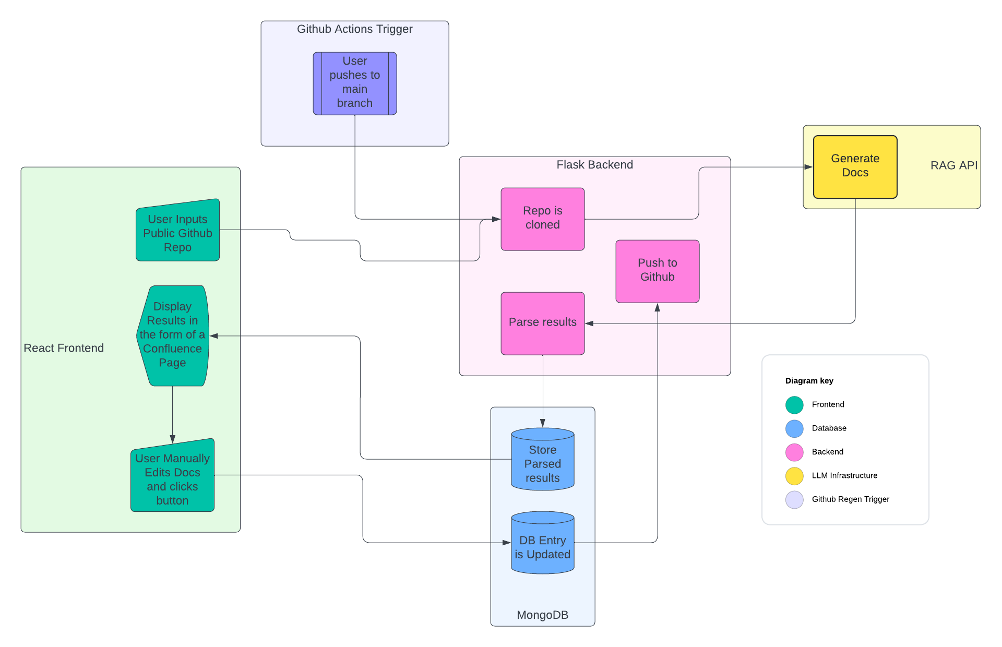
Where we are
Finalized the granular design
Cleaned up documentation
Made adjustments to the overall architecture based on the granular design
Implemented a basic infrastructure
React FE talking to a Flask BE

Slide 3
Where we’re going
Finishing the initial infrastructure
Will allow for the developers to develop more independently
Creating a standard Git workflow
Building up the basic parts of the application
Implementing a Jira board

